Slide 1


SHETran Results Viewer
Guidance for users

Slide 2
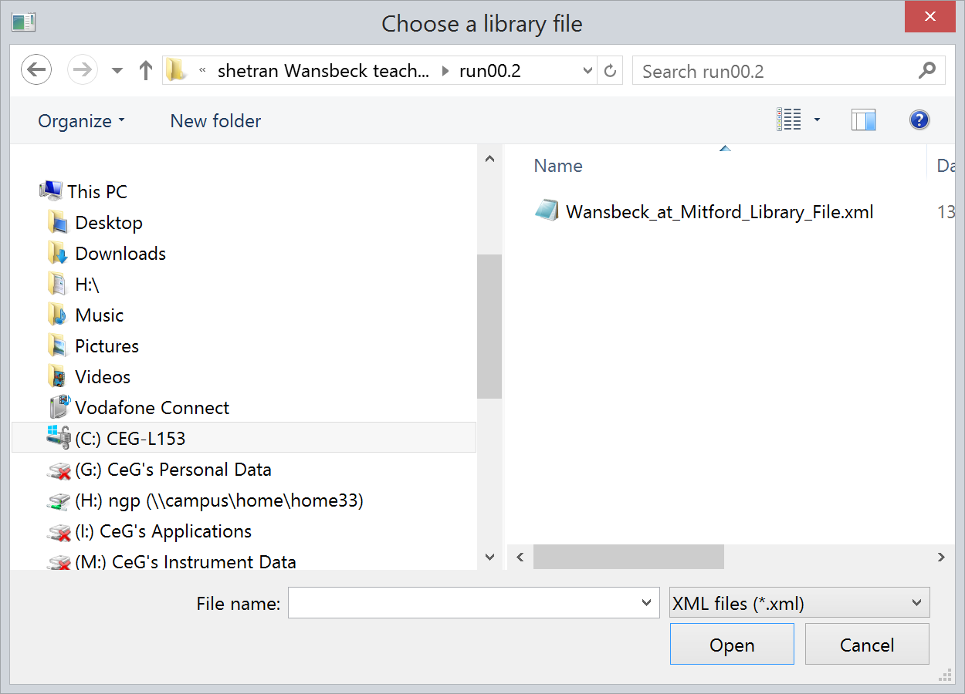
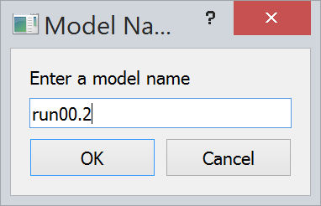
Run the program SHETran-Results-Viewer-*.*.*.exe
Select library file (.xml) from model folder
Enter model name (or accept default)

Slide 3
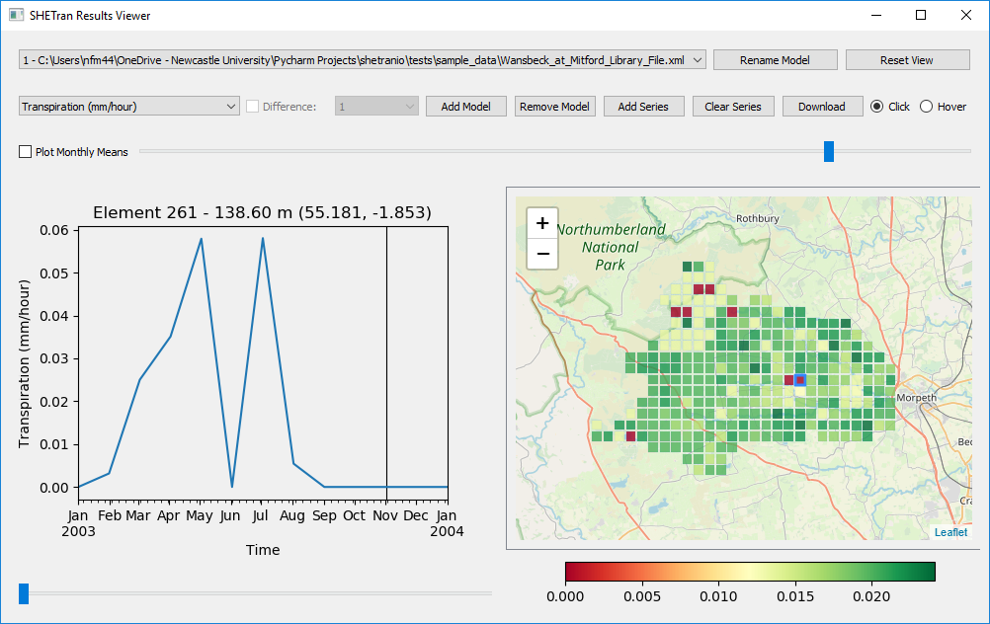
Select variable
Drop-down list of variables available for this model run
Note: different variables can be defined during model setup

Slide 4
Add model
Results from multiple models can be shown for comparison

Slide 5
Model list
List of available models, showing full folder path

Slide 6
Rename model
Renames the selected model

Slide 7
Remove model
Remove model from list (only works if multiple models present)

Slide 8
Map display
Shows selected variable for selected model run

Slide 9
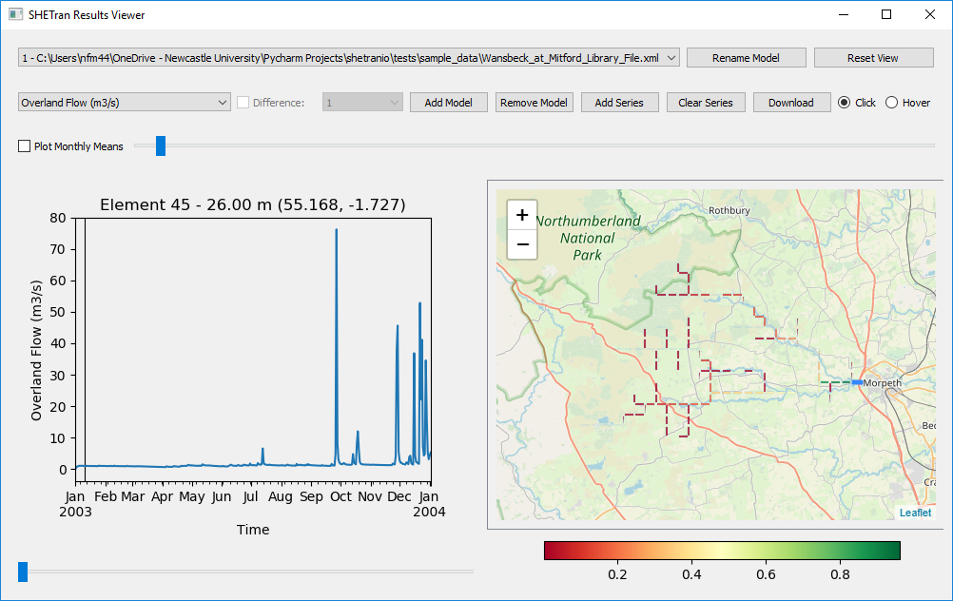
Map display
Some variables are set up only for the river network
For example, to show the catchment discharge hydrograph, select
Overland Flow (m3/s) variable
River outlet link

Slide 10
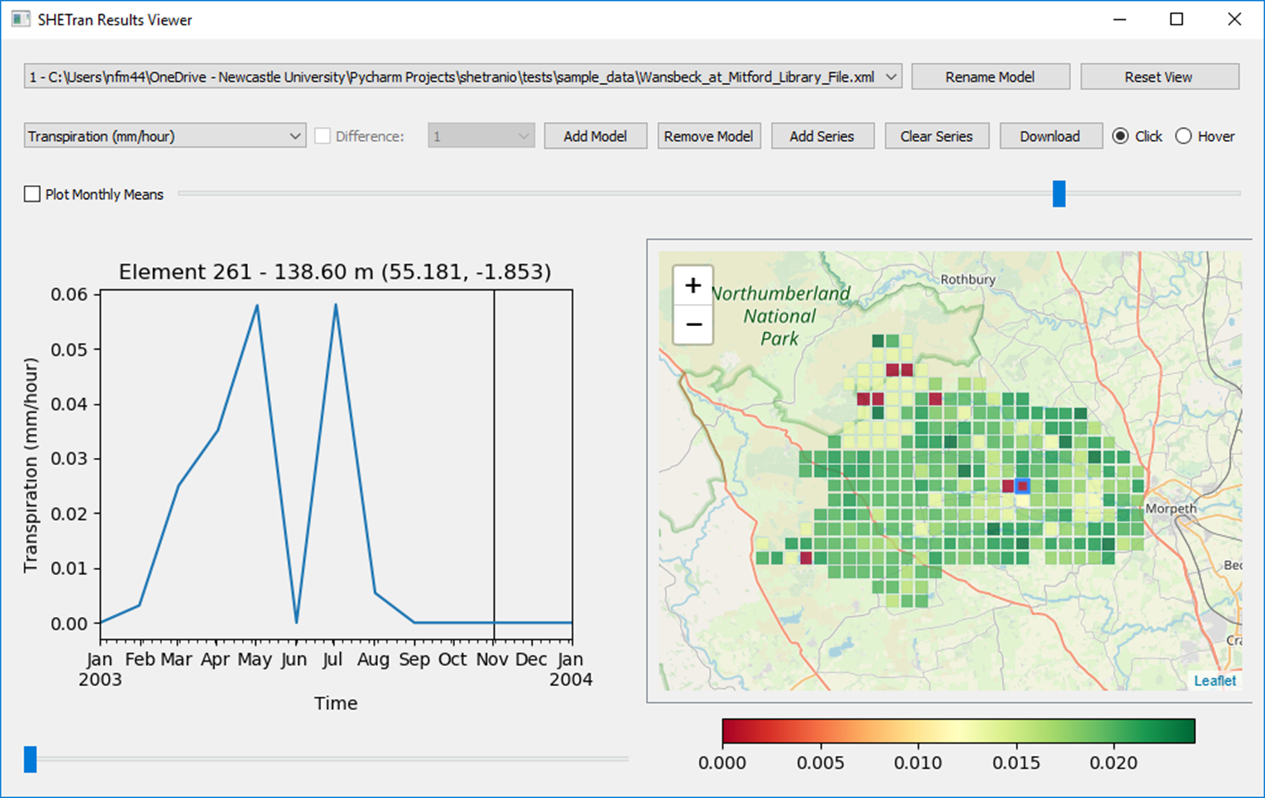
Reset view
Centres the model view

Slide 11
Graph plot
Shows time-series graph for selected grid element for one or more model runs
Title shows:
Element number
Ground elevation
X,Y real world co-ordinates

Slide 12
Click/hover
Radio button to allow click or hover cursor over map grid elements, to select data for graph display

Slide 13
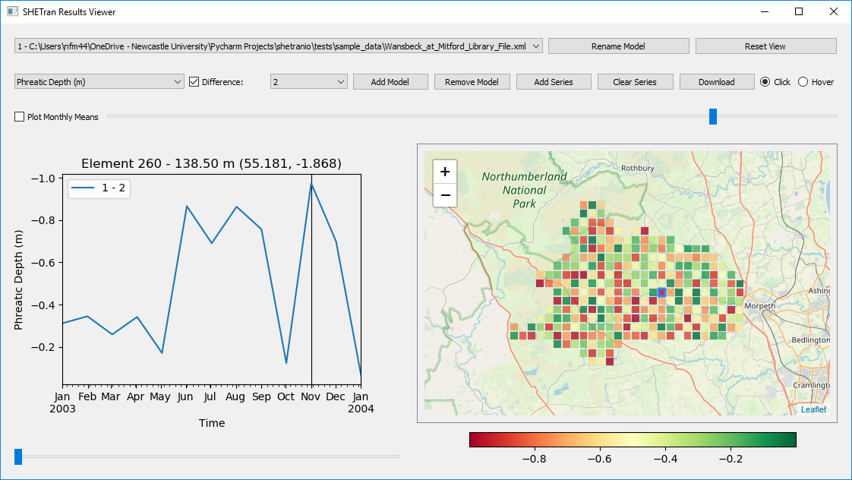
Difference
Check box to show difference between two model runs
Plot shows difference between first model and another model selected from the drop-down list

Slide 14
Time slider bar
Click and drag to animate the map view

Slide 15
Zoom slider bar
Click and drag to zoom the graph display around the selected time

Slide 16
Add series
Add a time-series from a .csv file with one date column and one data column (any additional data columns will be ignored)
Can be used for comparison with observed data
Note: the data will be shown on the graph until the ‘Clear Series’ button is pressed or difference mode activated

Slide 17
Download
Download the visible graph time-series data to a .csv file

Slide 18
Monthly Means
Option to resample values into a monthly time series

Slide 19
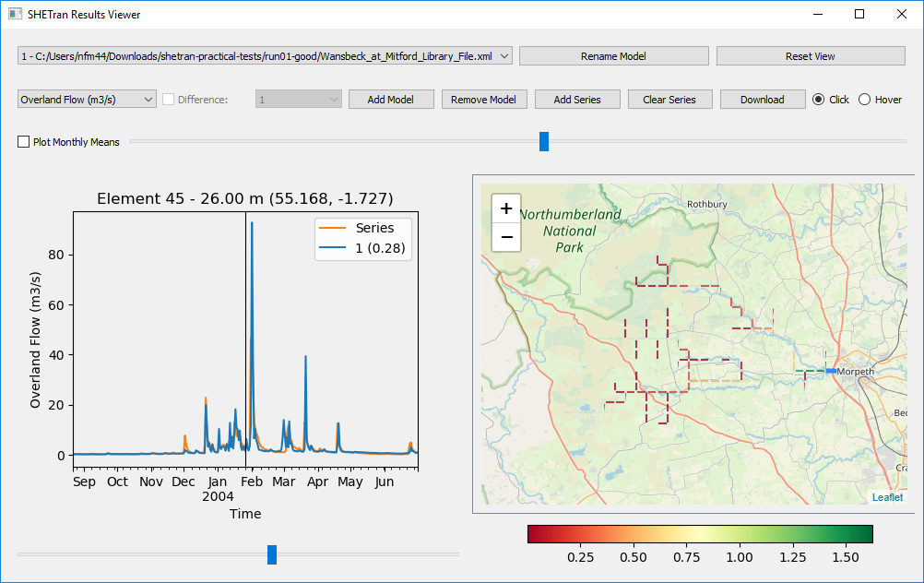
NSE
Nash Sutcliffe Efficiency is shown in brackets when an observed series is present

